Slide 1

TeCH ON FIRe

Slide 2

LLM WOrkshOP

Slide 3
What is
An LLM ?
LLM =
Large
Language
Model

Slide 4
What is
An LLM ?
“Why do apples...”
“…fall from trees”
“…turn brown when cut?”
“…float in water?”

Slide 5
What is
An LLM ?
“I have a bug. Can you help?”
Are you sick?
Do you need an exterminator?
You heard something?
Is your code broken?

Slide 6
Using
LLMs
Text Generation
Translation
Answering Questions
Summarizing Text
Text Completion
Code Generation
Content Moderation
Searching
Sentiment Analysis
Brainstorming
Grammar Checking

Slide 7
What is
An LLM ?
Parameters – the number of “knobs” available on the LLM.
Tokens/Prompt – what you provide to the LLM as part of your query.
Batch Size – the size of the test data used for generating an LLM.
Training
Data
Training
Candidate
Model
Validation
Output
Model
Dataset
Testing
Data

Slide 8
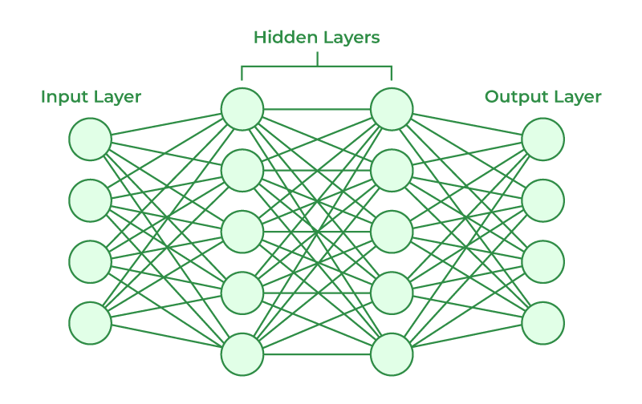
What is
An LLM ?

Slide 9
What is
An LLM ?

Slide 10
PrOmpt engineering
Zero-Shot Prompting: Providing a task without prior examples, relying on the model's pre-existing knowledge.
One-Shot Prompting: Giving the model one example before the actual task to guide its response.
Few-Shot Prompting: Supplying a few examples before the actual task to help the model understand the desired output.
Chain-of-Thought Prompting: Breaking down complex tasks into intermediate steps to guide the model to a solution.
Self-Improving Prompt: Allowing the model to reflect on and iteratively refine its own responses.
Instruction-Based Prompting: Using clear and direct instructions to specify the task, format, tone, or content.
Analogical Reasoning Prompt: Leveraging analogies to help the model draw parallels and approach new tasks.
Hybrid Prompting: Combining elements from various prompting techniques for complex or nuanced tasks.

Slide 11
Direct InvOcatiOn
(Zero-Shot,
Multishot)
API
Client
App
Context
LLM Model
(Pretrained)
Client
App
Context
Client
App
Context
External Context
Docs, hardcoded, database, etc.

Slide 12
Natural Language
TO SQL
Searches
Sources
Ingest
Search Data
API
Client
Apps
Client
Apps
Sources
Store
Client
Apps
Search
Sources
LLM Model
(Pretrained or Finetuned)
NL to SQL
NL to SQL

Slide 13
VectOr
Searches
Sources
Ingest
Vectorized Data
API
Client
Apps
Client
Apps
Sources
Embed
Client
Apps
Search
Sources
LLM Model
(Pretrained or Finetuned)
Vectorize
Vectorize
Generate

Slide 14
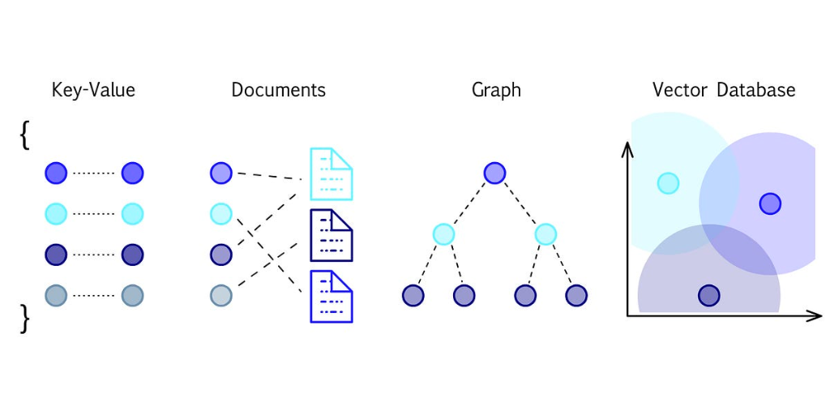
VectOr
Databases

Slide 15
Vector
Databases
Banana
Apple
Orange
Dog
Cat
Squirrel
Turtle
Eagle
T-Rex
Lizard
Crocodile
Chicken
Dove

Slide 16
What is
Retrieval
Augmented
Generation (RAG)?
Query Formulation: The process starts with the user input or query.
Information Retrieval: A retriever model searches a large dataset or knowledge base for relevant information.
Content Selection: The system filters and ranks the retrieved information to find the most relevant content.
Response Generation: A generator model creates a response using the selected content and the original query.
Refinement and Output: The generated response is refined for coherence and presented to the user.

Slide 17
RAG
Apps
Sources
Ingest
Vectorized Data
API
Client
Apps
Client
Apps
Sources
Embed
Client
Apps
Search
Sources
Embedding Model
(Pretrained or Finetuned)
Vectorize
Vectorize
Generative Model
(Pretrained or Finetuned)
Generate

Slide 18
COmbining MOdels
API
Client
App
Context
LLM Model
(Pretrained)
Client
App
Context
Client
App
Context
AI Model
Vision, Speech Recognition, etc.

